Slide 1


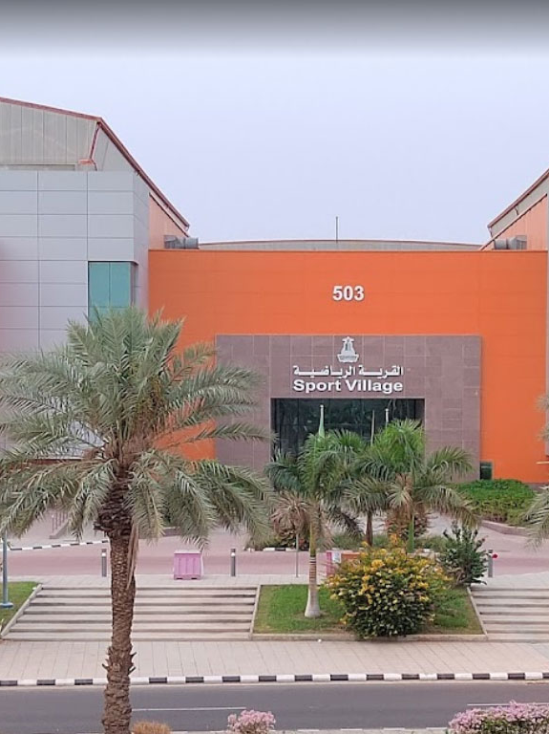

By Group 4: Zayed Mohammed Abdullah Alharbi Faisal Othman Faisal Al Ragheeb
2023
KAU SV

Slide 2

Problem Description
disconnection between the facility and users
unnecessary work for the trainers
congestion by the gates

Slide 3
Objectives & Goals
increase the connection
increasing participation
simplyfying the booking process
improve the trainer's ability
decreasing the congestion
improving the results

Slide 4
Functional Requirements
R1: The system should allow users to register an account.
R2: The system should allow users to sort sports by kind.
R3: The system should specify a capacity for each event.
R4: The system should allow users to add their favorite types of sports to their favorites list.
R5: The system should allow the user to view account information.

Slide 5
Non-Functional Requirements
R1: The system must allow users to select from several languages.
R2: The system should be able to run on any platform.
R3: The system must be accessible around the clock.
R4: The system should provide the user with a QR code.
R5: The system should require the user to create a strong password.

Slide 6
Domain Analysis
365 Scores
MyFitnessPal
fitness time
Activities schedule
Food tracking
QR code & training plan

Slide 7
Included
Log in
system
QR code
system
Activity
schedule
Maps
Booking
system
Workout
plan
Food tracker

Slide 8
Excluded
Payment
method
Purchasing
sports equipment
Other
branches
Hiring
new staff
+

Slide 9
Difficulties & risks
GYM
Technical
Security
Financial
Reputational

Slide 10
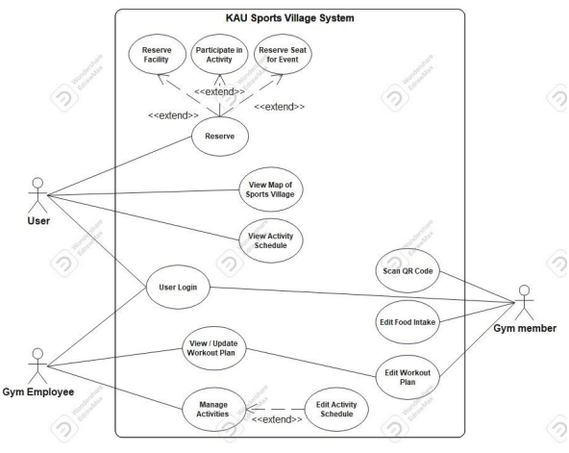
UML Use case Diagram

Slide 11
Use case description
03
01
Food intake
Brief description: measuring the nutrition the user consumed.
Actor: User.
Precondition: the user should be a gym member.
Basic flow of events: The user should log in to his account. The user should select his food from the database. The user should customize the selected food. The user confirms his selection.
Extensions: • The user didn't find the food he is looking for; He can customize the ingredients himself. • The user cannot connect to the database; The system displays a message "system error, please try again later"
Postcondition: Display the nutrition and calories consumed.
Special requirements: The user is required to have internet connection.

Slide 12
Use case description
03
02
Workout plans
Brief description: The user builds his workout routine from a selected database.
Actor: User.
Precondition: The user should be a gym member.
Basic flow of events: The user should log in to his account. The user should select the working day. The user should select his workout from the database. The user should select the number of sets & reps. The user confirms his selection.
Extensions: • The user didn't find the workout he is looking for; The system displays similar workouts that may have different name. • The user couldn't connect to the database; The system displays message "system error, please try again later".
Postcondition: Display the selected workout based on the day.
Special requirements: The user is required to have internet connection.

Slide 13
Use case description
03
03
Reservations system
Brief description: The reservation System allows users to book facilities, seats to watch events, and more.
Actor: User & gym facility.
Precondition: The user has the app and is logged in.
Basic flow of events: The user opens the app and logs in. The user selects the “Reservations” option from the menu. The user chooses what type of place to reserve. The user selects the time for the reservation. The system displays the availability of the place at the selected time. The system confirms the reservation via email to the user.
Extensions: • The selected time is unavailable; The system suggests another time for the user.
Postcondition: The reservation is confirmed in the system and the user gets confirmation via email.
Special requirements: The user is required to have internet connection. The app must handle any modification and cancelation that occurs. The app must have the real-time information feature of the sports village.

Slide 14
Use case description
03
04
Activity schedule
Brief description: Real-Time Information feature provides users with up-to-date information about the facilities, event calendars, class schedules, and more.
Actor: User.
Precondition: The user has the app and is logged in.
Basic flow of events: The user opens the app and logs in. The user selects the “Real-Time Information” option from the menu. The app displays the latest information from the Sports Village to the user, such as class schedule information.
Extensions: • The app can't deliver real-time information; The system displays message containing the cause. • The user can't find the desired information easily; The user can use the filter and search for the information.
Postcondition: The user is getting Real-Time Information on the desired Information of events, availability of facilities, updates, etc.
Special requirements: The user is required to have internet connection.

Slide 15


UML DIAGRAMS

Slide 16
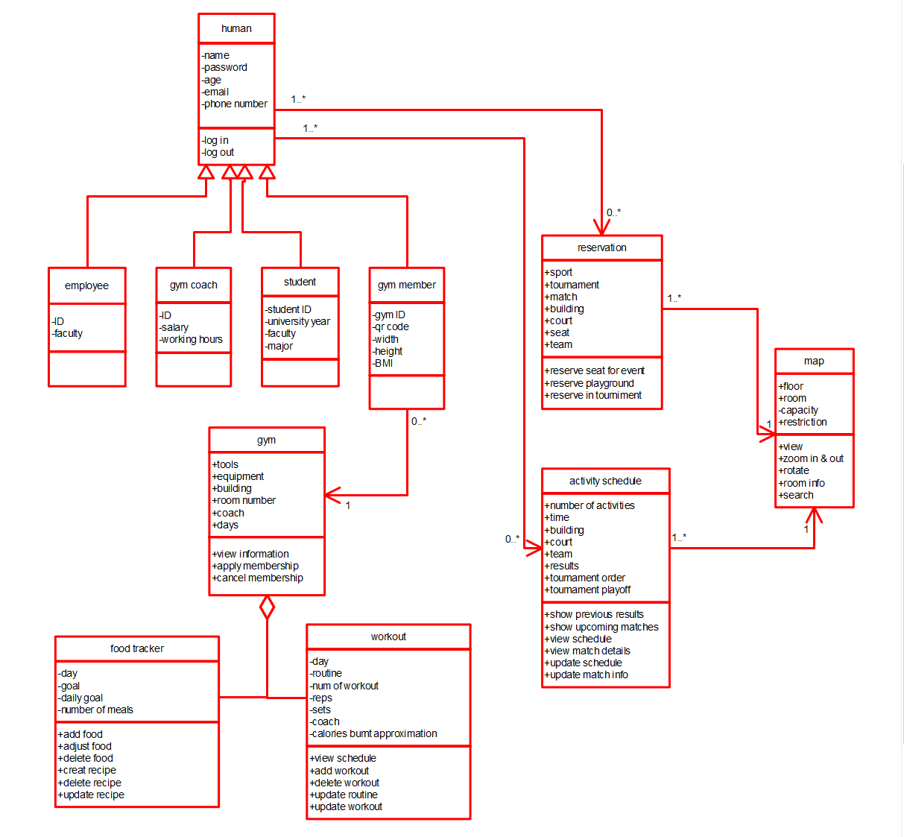
Class Diagram

Slide 17
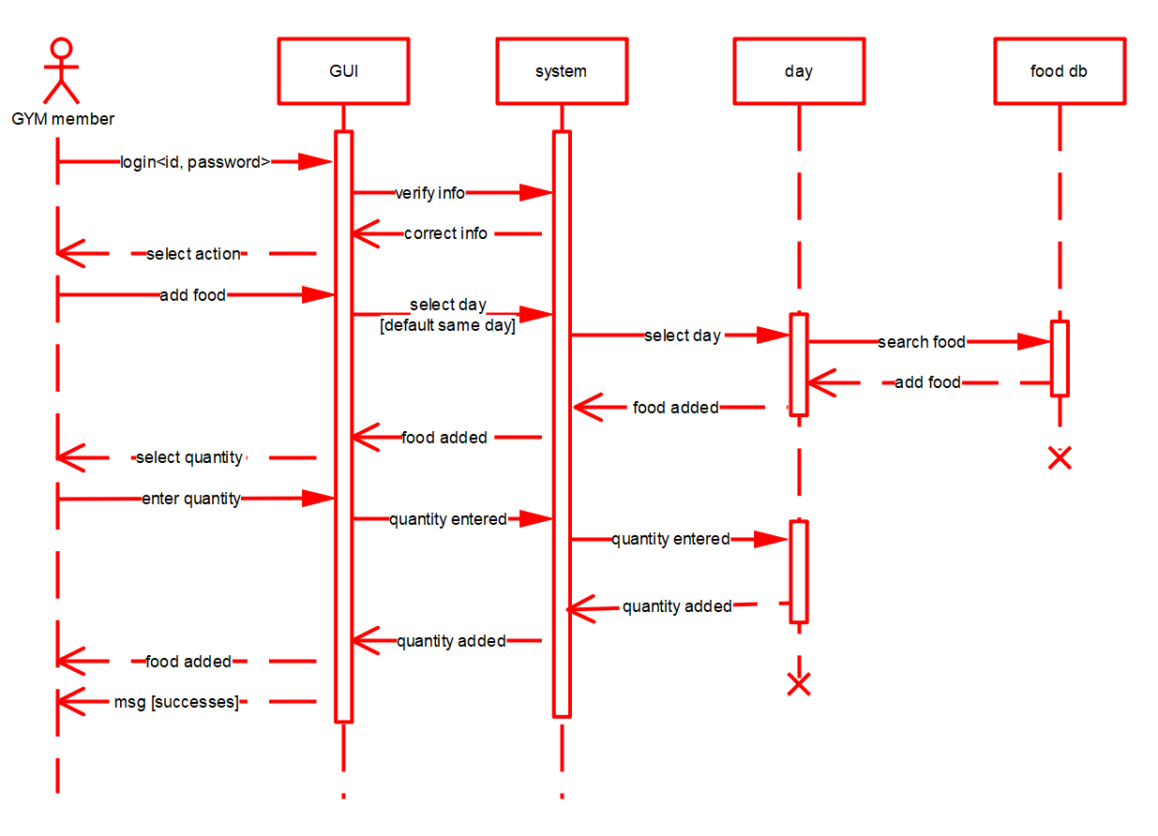
Sequence Diagram

Slide 18
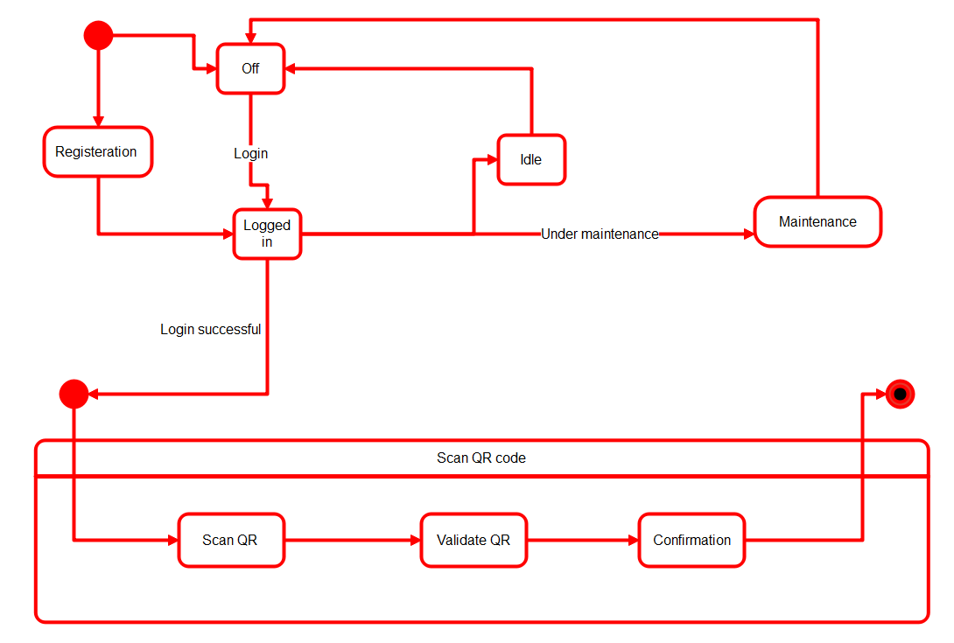
State Diagram

Slide 19
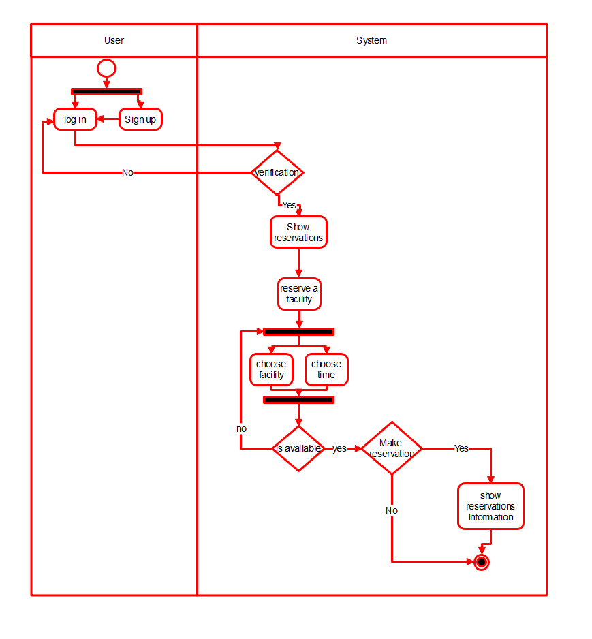
Activity Diagram

Slide 20
TESTING
Testing Objectives:
Extracting major errors
Check requirements functional & non-functional
Check main features
Check overall performers and security
Testing strategy:
Only on major functionalities for smooth flow
We will test 3 functionalities:
Reservation system
Activity schedule
QR code

Slide 21

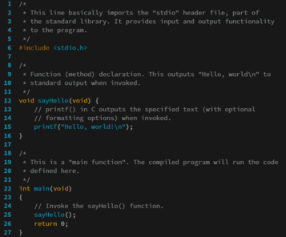
Testing approach:
Testing on two main groups
Development team – white box approach
Potential user – black box

Slide 22
PLAN 1:
 | Test scenario | Test steps | Test data | Expected results | Actual results | Pass/fail
1 | Test system's reaction when user wants to reserve a free playground | 1.login 2.choose reservation option 3.choose reserve a playground 4.choose the playground 5.choose the time to be reserved | Playground availability at the selected time User ID and name | Playground is free and reserved successfully | Reservation completed | Pass
2 | Test system's reaction when user wants to reserve an occupied playground | 1.login 2.choose reservation option 3.choose reserve a playground 4.choose the playground 5.choose the time to be reserved | Playground availability at the selected time User ID and name | Playground is occupied and cannot be reserved at the selected time | Reservation error, select another time | pass
System:
KAU SV
Test case name:
Reserve a playground
Precondition:
user has a valid
KAU account

Slide 23
PLAN 2:
 | Test scenario | Test steps | Test data | Expected results | Actual results | Pass/fail
1 | Test system's reaction when user checks activity schedule when there are activities | 1.choose activity schedule option | Activities in schedule Activities time & date Activities participants teams | List of activities in the schedule with the time and date and participants teams | Activities list displayed with time and date and activity participants | Pass
2 | Test system's reaction when user checks activity schedule when there are activities | 1.choose activity schedule option | Activities in schedule Activities time & date Activities participants teams | No activities in schedule to be listed | Activities list is empty | pass
3 | Test system's reaction when user selects activity to see activity details | 1.choose activity schedule option 2.select activity | Activity's time & date Activity's building Activity's playground Activity's participants teams | Shows time and date of the activity and a count down to the activity start and the building and number of playground with the participated teams | Activity's details will be shown (time, date, count down, building, playground, participated teams | pass
System:
KAU SV
Test case name:
Display activity schedule
Precondition:
user has a valid
KAU account

Slide 24
PLAN 3:
 | Test scenario | Test steps | Test data | Expected results | Actual results | Pass/fail
1 | Test system's reaction when user tries to get a QR code to enter the gym | 1.login 2.choose QR code option | User ID User name User membership user default phone | System generates new QR code to enter the gym | New QR code generated with access to the gym | Pass
2 | Test system's reaction when user tries to get a QR code to enter the gym but not on default phone | 1.login 2.choose QR code option | User ID User name User membership user default phone | System display's message that its not the default phone and to change it contact with the sports village | Message displayed " not default phone, if you want to change the default device contact sports village | pass
3 | Test system's reaction when user tries to get QR code while not a gym member | 1.login 2.choose QR code option | User ID User name User membership | System display's message that you are not a gym member | Message displayed "you are not a gym member" | pass
System:
KAU SV
Test case name:
Generate QR code
Precondition:
user has a valid
KAU account,
user is a gym member,
user phone is the
default phone

Slide 25
Conclusion
ENERGY
KAU SV
Problem
GOALS
Data
Testing

Slide 26
Thank you By: Group 4
2023
PUSH

